Slide 1
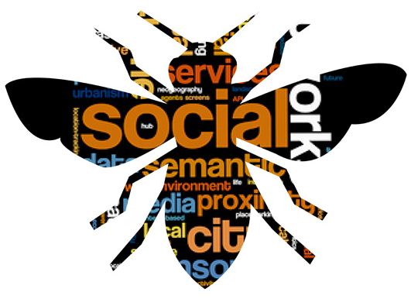
Digital Disciples
Radical Hospitality through Social Media
February 20, 2016

Slide 2
Agenda
Introductions
What is Social Media?
What is Radical Hospitality?
Digital Interaction in Action
MAKE IT HAPPEN!
Questions
Workshop Feedback and Evaluation

Slide 3
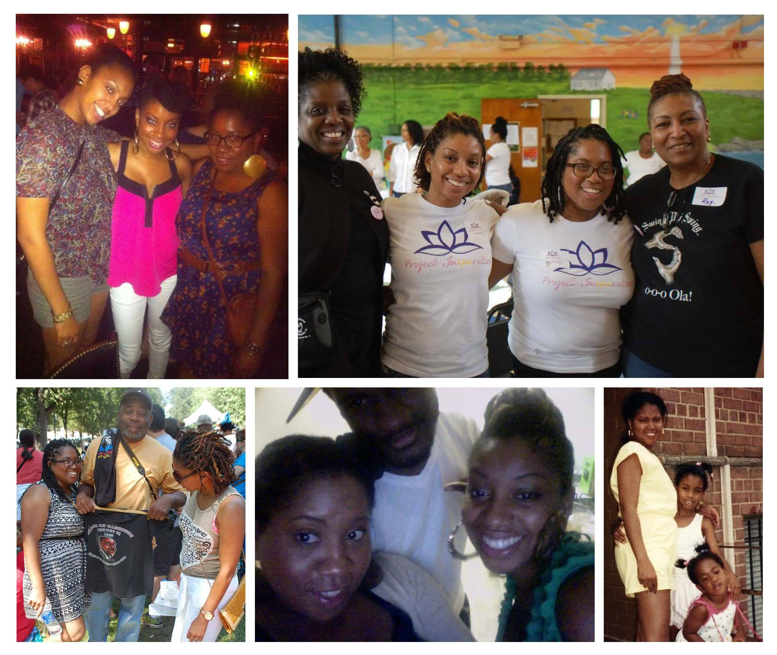
Introduction
Brittney Drakeford
Hipster Philanthropist
Gethsemane UMC
Contact
  Email – britt.drake@gmail.com
  Twitter - @brittneythenerd
  Web – brittneythenerd.com

Slide 4
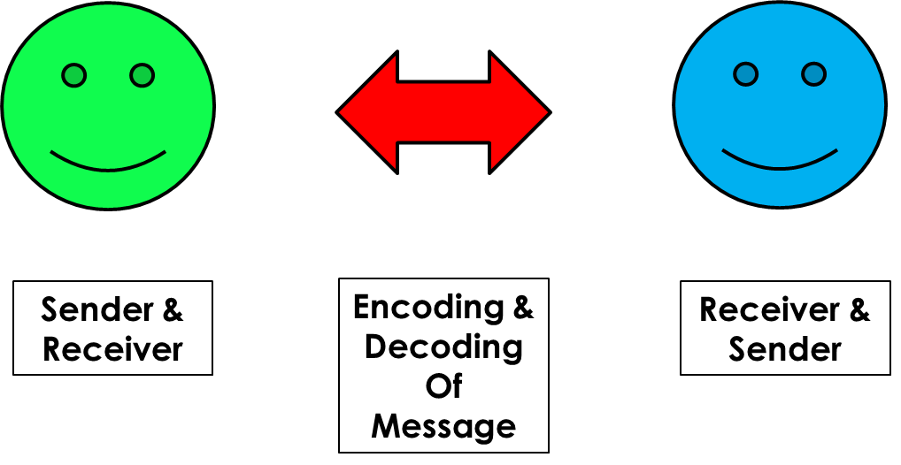
Communication
The imparting or exchanging of information or news.
Means of connection between people or places, in particular.
HOW DO YOU COMMUNICATE?

Slide 5

What is Social Media?

Slide 6
Have you done the following?
Participated in a Phone Tree
Talked to a neighbor
Played Candy Crush
Taken a selfie
Uploaded a picture to Facebook
Attended a community meeting
Used a Pen, Pencil, or Tablet
If you have done any of these, then you have practiced social networking

Slide 7
Social Network or Social Media
Social Network is structure made up of a set of social actors (such as individuals or organizations) that have a relationship or interaction with each other and multiple people.
Social Network is a RELATIONSHIP
Social Media is any website and application that enable users to create and share content or to participate in social networking.
Social Media or Social Networking Site is a DIGITAL MEETING PLACE

Slide 8
Purpose of Social Media
Tool for communication
Create a community virtually
Connect with OLD people and OLD ideas
Connect with OLD people and NEW ideas
Connect with NEW people and OLD ideas
Connect with NEW people and NEW ideas

Slide 9
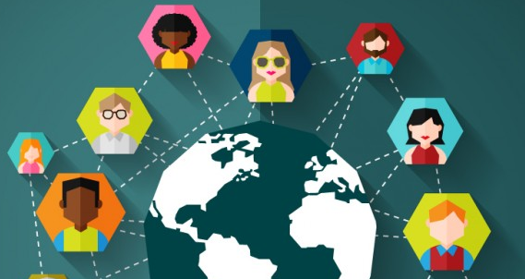
We're all connected

Slide 10
Types of Social Media
Blogs
Microblogs
Wikis
Discussion Forums
Video Shares
Email
Voip (Skype, Ovoo, Google Voice)
Video Games
Digital Communities

Slide 11








Popular Social Media Sites

Slide 12
Church Benefits to Social Media
Inexpensive method to reach out to congregation
Inform church members and visitors
Increase intergenerational mentoring,
Outreach to new members
Evangelize to those who are seeking salvation
Go Green to Save Money

Slide 13
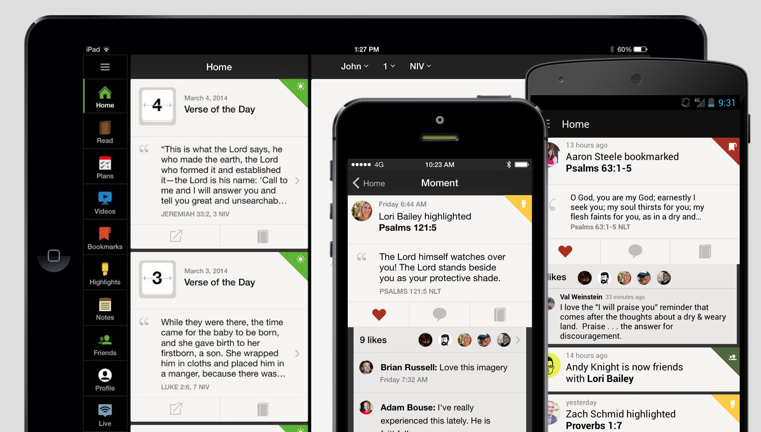
What does the Bible say?
Notes:
Commnuication the imparting or exchanging of information or news.
"direct communication between the two countries will produce greater understanding"
synonyms:transmission, conveyance, divulgence, disclosure; More
2.
means of connection between people or places, in particular.

Slide 14
Biblical Communication
Matthew 18:19-20
For where two or three gather in my name, there am I with them.
Ecclesiastes 4:9-10
Two are better than one, because they have a good return for their labor: If either of them falls down, one can help the other up. But pity anyone who falls and has no one to help them up
Acts 4:31
And when they had prayed, the place where they had gathered together was shaken, and they were all filled with the Holy Spirit and began to speak the word of God with boldness.

Slide 15
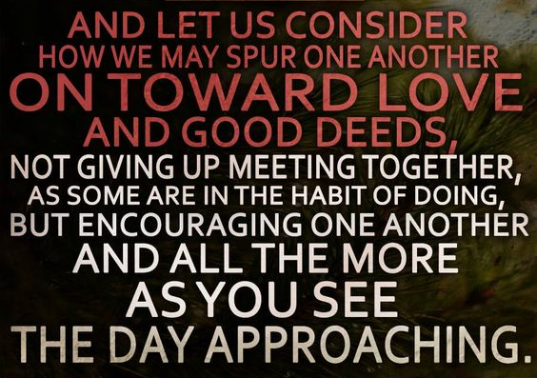
What does the Bible say?
Hebrews 10:24-25

Slide 16
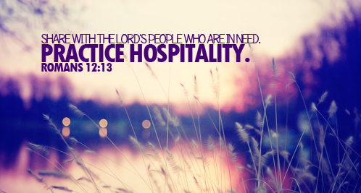
What is Radical Hospitality?

Slide 17
Radical Hospitality
Radical: very new and different from what is traditional or ordinary
Hospitality: the friendly reception and treatment of guests or strangers.
Radical Hospitality: Practice of putting extraordinary effort and emphasis on making people feel welcome. Requires intentional invitation and welcome.
Notes:
http://www.umcom.org/learn/is-it-time-to-move-from-friendly-to-radical-hospitality
http://www.grassrootssolutions.com/2014/07/10-ways-to-create-a-culture-of-radical-hospitality/
Originating in communities of faith, radical hospitality—a term coined by Father Daniel Holman and Lonni Collins Pratt, in their 2002 book, Radical Hospitality: Benedict’s Way of Love—can be defined as a practice of putting extraordinary effort and emphasis on making people feel welcome. This is why the concept is often referred to as “radical welcome.” It is about breaking down barriers that keep people from ongoing participation in an effort, movement, community, or campaign. It has been calledthe art of revolutionizing access—everybody is in, and nobody is out.
“Radical hospitality” requires intentional invitation and welcome. It goes beyond greeters at the door and handshakes during worship to welcome every person as an honored guest.
radical hospitality is a concept that seeks to apply the principles of access and inclusion that can help traditionally underrepresented communities become more engaged, and help those who are already engaged stay motivated.

Slide 18

This relate to Social Media how?

Slide 19
Let's Do the Math
Social Media = Digital Gathering Place
Relationship = Person + Person
God’s Presence = (2 x Person) + Gathering
God’s Presence = Relationship + Social Media

Slide 20
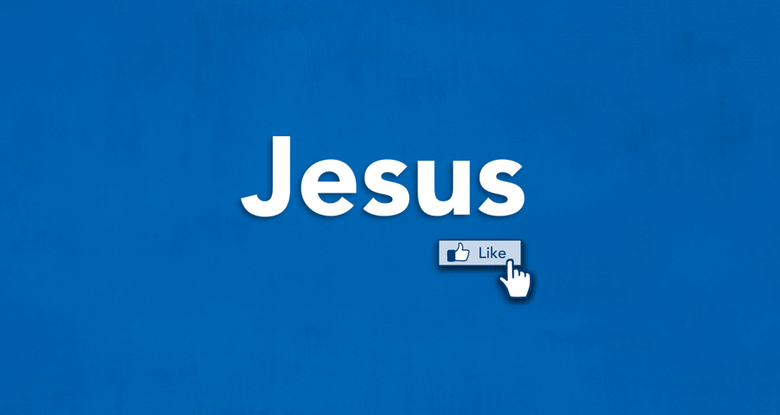
Who Would Jesus Friend

Slide 21
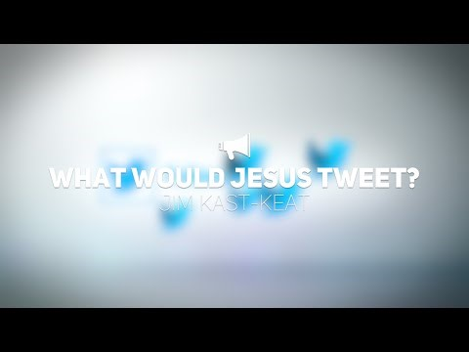
https://www.youtube.com/watch?v=-Tci9EYMmAY

Slide 22
Who Would Jesus Friend?
Who does Jesus accept?
How does he accept them?
What does he say to them?
What does he do for them?

Slide 23
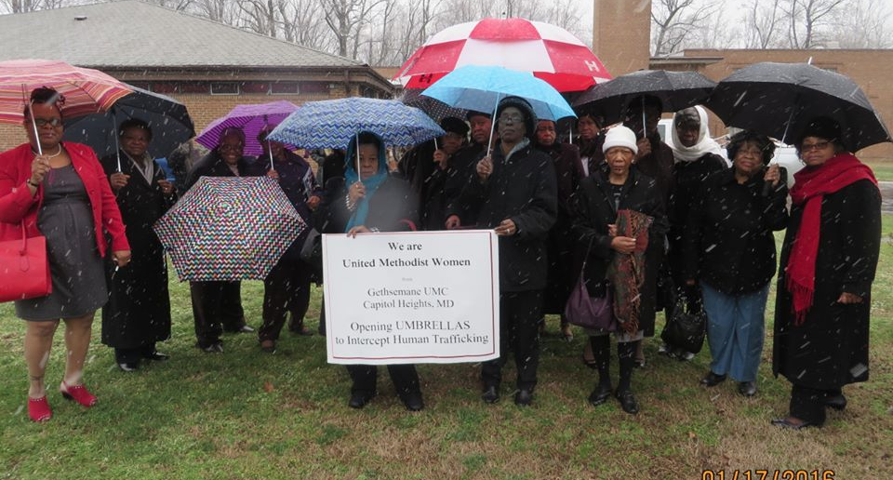
Let's See it In Action

Slide 24
Gethsemane UMW
UMW Unit Meetings
Contact Database and Email Reminders
Women's Day 2015
Intergenerational Committee and Social Media Posts
#UmbrellasforTrafficking
UMW Social Media Campaign

Slide 25
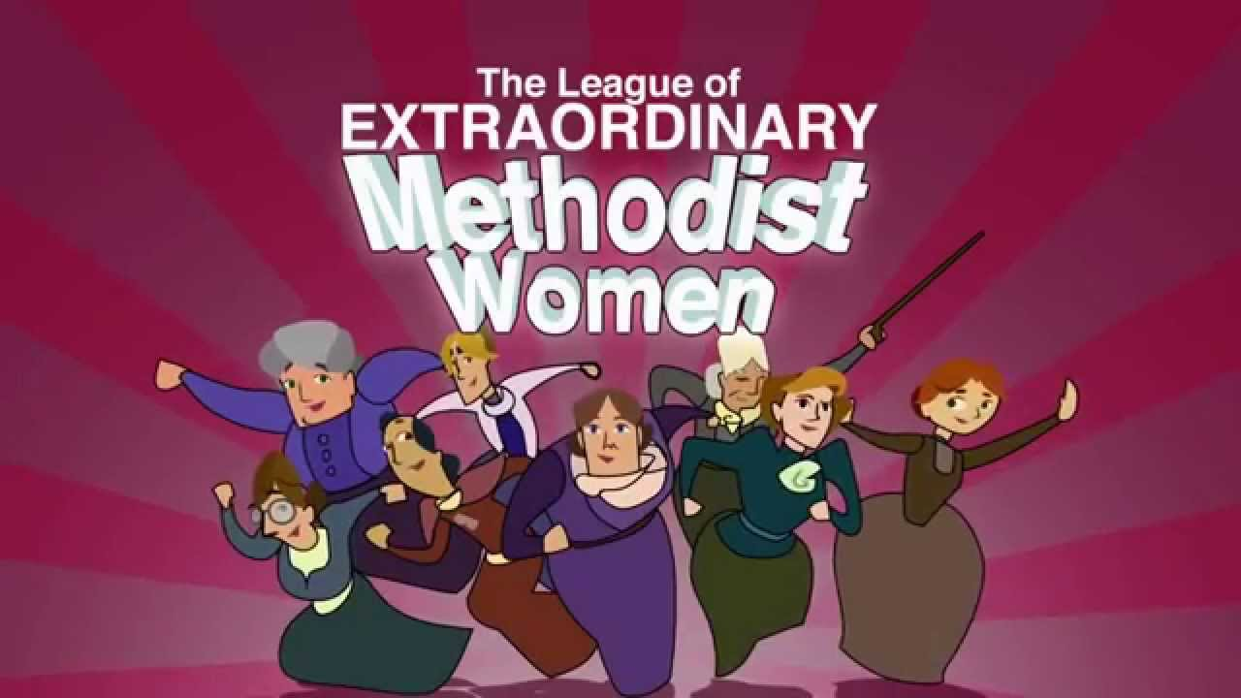
How can we MAKE IT HAPPEN?

Slide 26
Recommendations
Create a Intergenerational Committee
Survey the digital landscape
Develop a home for information
Encourage digital discipleship and advocacy

Slide 27

https://www.youtube.com/watch?v=i-8oN2cDFQo

Slide 28
Questions?

